Slide 1
Movie Recommendation System
Building collaborative suggestions using data science fundamentals
By: Shobbika T - 240701502
Shreya K S - 240701506
Shiloh S - 240701498

Slide 2
Introduction & Scope
This project demonstrates how real-world platforms like Netflix and IMDb
leverage data science to understand viewer preferences.
Using a comprehensive movie dataset with ratings, tags, and user behavior, we'll build a
recommendation engine that identifies patterns and suggests films tailored to
individual tastes.
Through data preprocessing, exploratory analysis, and
machine learning models, you'll discover how data transforms into personalized
experiences.

Slide 3
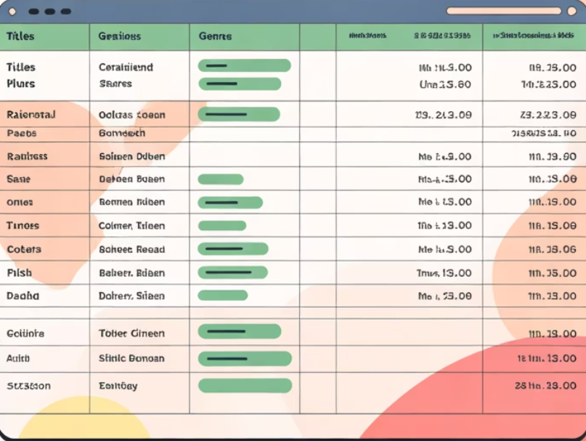
The Dataset Sourcing
1.Movie Information
Titles, genres, release dates, runtime, and metadata
2. User Ratings
Individual scores and temporal patterns from viewers
3. Behavioral Tags
User-generated keywords describing movie characteristics

Slide 4

Data Preprocessing & Cleaning
1. Handle Missing Values
Identify and manage incomplete records using imputation or removal strategies appropriate for each feature.
2. Detect Outliers
Find unusual ratings or viewing patterns that may skew analysis using statistical methods and visualization.
3.Scale Features
Normalize numerical data to ensure all variables contribute equally to machine learning models.
4.Validate Quality
Confirm data integrity and consistency before proceeding to analysis and model building.

Slide 5
Exploratory Data Analysis
Quantitative Analysis Qualitative Analysis
1.Rating distributions and averages 1.Tag frequency and word clouds
2.Genre popularity metrics 2.Genre relationships and themes
3.Temporal trends in viewer behavior 3.User sentiment pattern
4.Statistical summaries and correlations 4.Content categorization insights

Slide 6
Feature Engineering & Relationships
Feature engineering transforms raw movie data into meaningful inputs for machine learning models. It involves creating derived features that capture movie similarities and user preferences — for example, an “average
critic-to-audience rating ratio” or a “genre diversity score.”
Categorical variables like genres and tags are converted into numerical form using one-hot encoding or embeddings.
Similarity measures such as Cosine Similarity and Euclidean Distance help quantify relationships between movies or users.
Correlations reveal key insights — e.g., Pearson for linear relationships (budget vs. revenue) and Spearman for non-linear ones (reviews vs. ratings).
These patterns guide clustering, grouping films with shared traits like critically acclaimed dramas or family animations.
Effective feature selection focuses models on the most predictive signals, improving accuracy and
efficiency while avoiding overfitting.

Slide 7
Model Selection
1. Evaluated multiple ML algorithms:
Linear Regression: Predict average ratings
Logistic Regression: Classify like/dislike responses
K-Nearest Neighbors (KNN): Recommend similar movies based on user behavior
K-Means Clustering: Group movies with shared features or genres
2. Choose the models based on performance, interpretability, and scalability

Slide 8
Evaluation & Interpretation
Evaluation Metrics:
Regression Models
  - MAE / RMSE: Measure prediction error in ratings
  - R² Score: Explains variance captured by the model
Classification Models
  - Accuracy, Precision, Recall, F1-Score: Evaluate like/dislike predictions
Clustering Models
- Silhouette Score: Measures cohesion and separation of movie clusters
  - Inertia: Quantifies compactness of clusters

Slide 9
Conclusion
Built a Movie Recommendation System using real-world data on movies, ratings, and
user preferences.
Applied a complete data science pipeline — from preprocessing and EDA to model training and evaluation.
Leveraged algorithms like Linear & Logistic Regression, KNN, and K-Means to uncover movie
similarity patterns.
Demonstrated the power of feature engineering and similarity measures in enhancing
recommendation accuracy.
Results show that data-driven methods can successfully personalize movie suggestions
similar to Netflix or IMDb.
Provides a strong foundation for future enhancements such as collaborative filtering,
deep learning models, or real-time recommendation systems.

